Slide 1

PLANNING

Slide 2

Does goal setting fit your management style?
Are you a good planner?
Do you set goals and identify ways to accomplish them?

Slide 3
Does goal setting fit your management style?
S. No. | Statement | Mostly True | Mostly False
1. | I have clear specific goals in several areas of my life.
2. | I have a define outcome in life I want to achieve.
3. | I prefer general to specific goals.

Slide 4
Does goal setting fit your management style?
S. No. | Statement | Mostly True | Mostly False
4. | I work better without specific deadlines.
5. | I set aside time each day or week to plan my work.
6. | I am clear about the measures that indicate when I have achieved a goal.

Slide 5
Does goal setting fit your management style?
S. No. | Statement | Mostly True | Mostly False
7. | I work better when I set more challenging goals for myself.
8. | I help other people clarify and define their goals.

Slide 6
Scoring
Give 1 point for Mostly True for 1, 2, 5, 6, 7, 8
1
Except 3, 4 statement.
2
Give 1 point for Mostly False for 3, 4 statement.

Slide 7
Interpretation
Score | Interpretation
5 or higher | Positive Level of Goal Setting Behaviour
4 or less | Evaluate and begin to change your goal setting behaviour

Slide 8

Concept of Planning
Primary of all managerial functions as it involves deciding of future course of action.
Planning involves defining the organization’s goals, establishing overall strategy for achieving goals, and developing a comprehensive set of plans to integrate, coordinate organizational work.

Slide 9
So, Planning is
Thinking Before doing
Deciding in advance : What to do, How to do it, When to do it, Where to do it, Why is it to be done and Who is to do it.

Slide 10
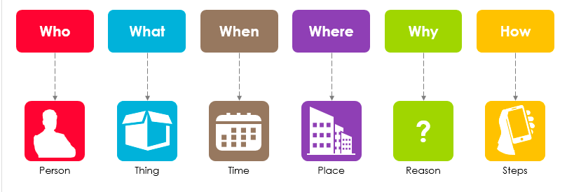
5W + 1H

Slide 11
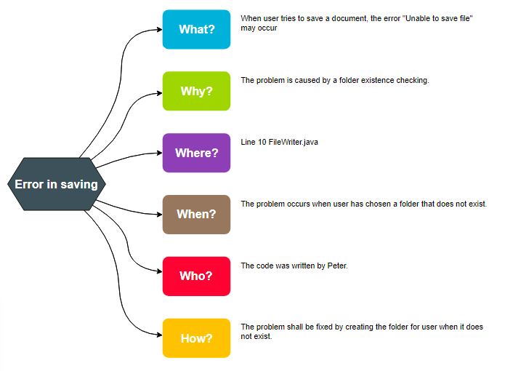
Example - Software Error

Slide 12
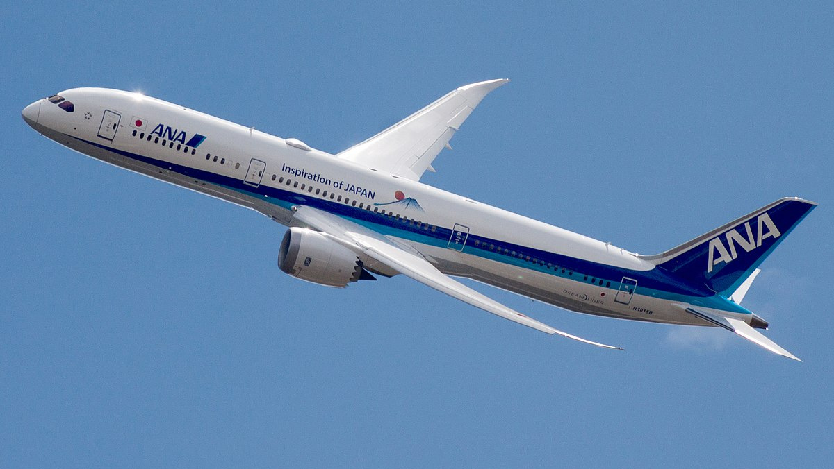
Case Study : Boeing 787 Dreamliner

Slide 13

Case Study : Boeing 787 Dreamliner
Boeing called its new 787 aircraft the Dreamliner, but the project turned into more of a nightmare for managers.
The new plane was the company’s most popular product ever, mostly because of its innovations, especially in fuel efficiency. However, the plane was two and a half years behind schedule.

Slide 14

Boeing admitted that the project’s timeline was way too ambitious even though every detail had been meticulously planned.
Some customers (the airlines who ordered the jets)—around 60 in total—got tired of waiting or responded to the changing economic environment and canceled their orders.
Notes:
American MNC that designs manufactures sells airplanes, rotorcrafts satellites missiles etc. worldwide

Slide 15

Question for Discussion
Could Boeing’s managers have planned better?

Slide 16

Why do Managers Plan?

Slide 17
Why do Managers Plan?
Why to Plan
Provides Direction
Reduces uncertainty
Minimizes waste and redundancy
Establishes the goals or standards used in controlling

Slide 18

Think upon
“One plan can be used at every place.”
Is this statement correct or need modification?

Slide 19
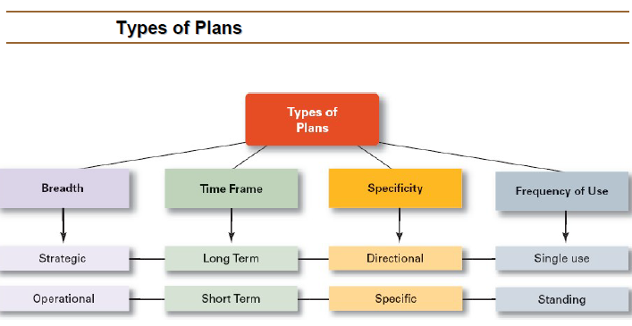
Types of Plans

Slide 20
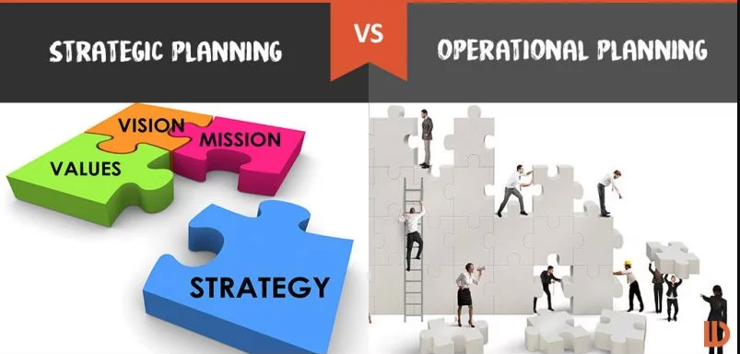
On the basis of Breadth
Notes:
Vision for future
How to achieve it on daily and weekly basis

Slide 21

On the basis of Breadth
Strategic Planning is about being different.
Operational Planning is about being better.

Slide 22

On the basis of Time-frame

Slide 23

On the basis of Time-frame
Short term plan is for specific departments or specific functions.
Long-term plan is for organization as a whole.

Slide 24
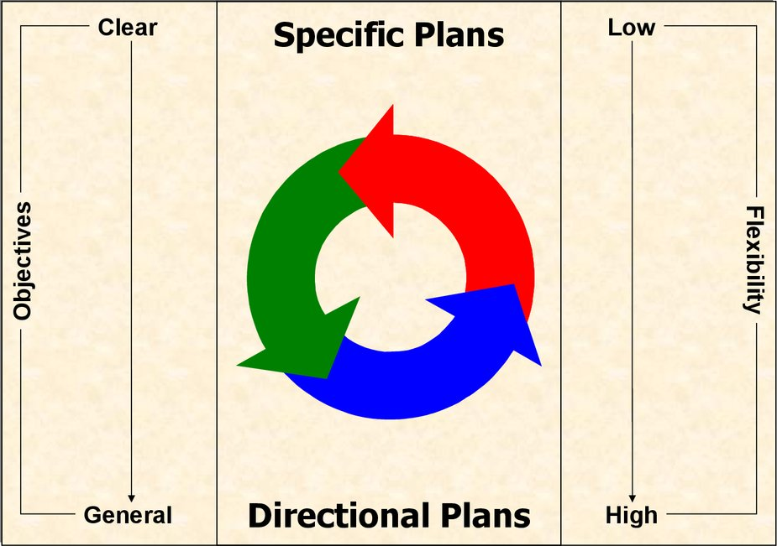
On the basis of specificity

Slide 25
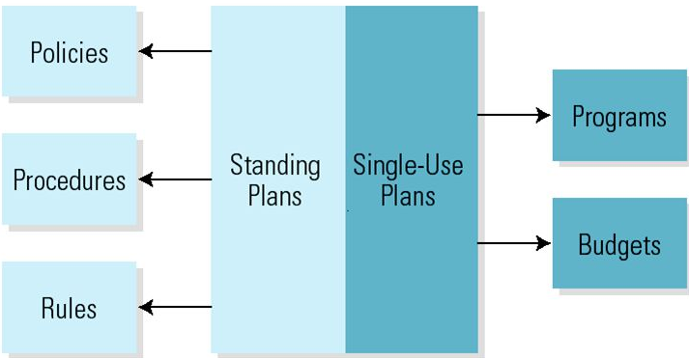
On the basis of frequency of use

Slide 26

How does a Manager plan?

Slide 27

Process of Planning
Setting objectives
Developing planning premises
Identifying alternative course of action
Evaluating alternative course of action
Selecting one best Alternative
Implementing the plan
Follow up action

